Slide 1
SOEN 343
09 Exception handling

Slide 2
Learning objectives
Explain why it is important to separate error code from business code
Explain the three type of exceptions in Java
Explain the difference between try and catch blocks and throwing exceptions
Develop you own exception classes
Implement exception handling in Java Code using advanced constructs
Recognize the error handling overhead and compare it with their benefits

Slide 3
Introduction
Programs are meant to work correctly within their specifications
However, during the execution of a program unforeseen circumstances might arise, that are outside of its specifications
Examples include:
When users attempt to use the program outside of its specified usage
When the program tries to use another program, or software component and faces unforeseen behavior
When the program misbehaves due to an internal logical error, or by being in an inconsistent state

Slide 4
Exception handling: error handling
Error handling code can create complexity in simple programs
There can be many different error codes, some error states can even be combinations of more than one error
The error code is a value to be returned. What if the functions also needs to return a value?
errorCodeType readFile (){
errorCode = 0;
//open the file;
if (theFileIsOpen) {
//determine the length of the file;
if (gotTheFileLength) {
//allocate that much memory;
if (gotEnoughMemory) {
//read the file into memory;
if (readFailed) {
errorCode = -1;
}
} else {
errorCode = -2;
}
} else {
errorCode = -3;
}
//close the file;
if (theFileDidntClose && errorCode == 0) {
errorCode = -4;
}
} else {
errorCode = -5;
}
return errorCode;
}

Slide 5
What Is an Exception?
An exception is an event, which occurs during the execution of a program, that disrupts the normal flow of the program's instructions
To be more structured, functions should be first programmed according to the specifications of their normal behavior, and clearly separate code should be provided for abnormal cases, i.e. cases outside of the function’s specifications of normal behavior
returnType readFile (){
// part of code that cannot fail;
try {
// open the file;
// determine its size;
// allocate that much memory;
// read the file into memory;
// close the file;
} catch (fileOpenFailed) {
// doSomething;
} catch (sizeDeterminationFailed) {
// doSomething;
} catch (memoryAllocationFailed) {
// doSomething;
} catch (readFailed) {
// doSomething;
} catch (fileCloseFailed) {
// doSomething;
}
// other part of code that cannot fail;
}

Slide 6
The Catch or Specify Requirement
Valid Java programming language code must honor the Catch or Specify Requirement. This means that code that might throw certain exceptions must be enclosed by either of the following:
A try statement that catches the exception. The try must provide a handler for the exception
A method that specifies that it can throw the exception. The method must provide a throws clause that lists the exception, as described in Specifying the Exceptions Thrown by a Method.
Code that fails to honor the Catch or Specify Requirement will not compile
Not all exceptions are subject to the Catch or Specify Requirement

Slide 7
The Three Kinds of Exceptions
Checked exception: Exceptional conditions that should be anticipated and recover from
Attempting to open a file that does not exist
Errors
Java virtual machine errors that prevent code for running
Runtime Exceptions
Null-pointer exceptions
unchecked
Notes:
Errors and runtime exceptions are collectively known as unchecked exceptions.

Slide 8
Catching and Handling Exceptions
public class ListOfNumbers {
private List<Integer> list;
private static final int SIZE = 10;
public ListOfNumbers () {
list = new ArrayList<Integer>(SIZE);
for (int i = 0; i < SIZE; i++) {
list.add(new Integer(i));
}
}
public void writeList() {
// The FileWriter constructor throws IOException, which must be caught.
PrintWriter out = new PrintWriter(new FileWriter("OutFile.txt"));
for (int i = 0; i < SIZE; i++) {
// The get(int) method throws IndexOutOfBoundsException, which must be caught.
out.println("Value at: " + i + " = " + list.get(i));
}
out.close();
}
}
The following example defines and implements a class named ListOfNumbers. When constructed, ListOfNumbers creates an ArrayList that contains 10 Integer elements with sequential values 0 through 9. The ListOfNumbers class also defines a method named writeList, which writes the list of numbers into a text file called OutFile.txt

Slide 9
Catching and Handling Exceptions
public class ListOfNumbers {
private List<Integer> list;
private static final int SIZE = 10;
public ListOfNumbers () {
list = new ArrayList<Integer>(SIZE);
for (int i = 0; i < SIZE; i++) {
list.add(new Integer(i));
}
}
public void writeList() {
// The FileWriter constructor throws IOException, which must be caught.
PrintWriter out = new PrintWriter(new FileWriter("OutFile.txt"));
for (int i = 0; i < SIZE; i++) {
// The get(int) method throws IndexOutOfBoundsException, which must be caught.
out.println("Value at: " + i + " = " + list.get(i));
}
out.close();
}
}
The following example defines and implements a class named ListOfNumbers. When constructed, ListOfNumbers creates an ArrayList that contains 10 Integer elements with sequential values 0 through 9. The ListOfNumbers class also defines a method named writeList, which writes the list of numbers into a text file called OutFile.txt
Is this code compilable?

Slide 10
Catching and Handling Exceptions
public class ListOfNumbers {
private List<Integer> list;
private static final int SIZE = 10;
public ListOfNumbers () {
list = new ArrayList<Integer>(SIZE);
for (int i = 0; i < SIZE; i++) {
list.add(new Integer(i));
}
}
public void writeList() {
// The FileWriter constructor throws IOException, which must be caught.
PrintWriter out = new PrintWriter(new FileWriter("OutFile.txt"));
for (int i = 0; i < SIZE; i++) {
// The get(int) method throws IndexOutOfBoundsException, which must be caught.
out.println("Value at: " + i + " = " + list.get(i));
}
out.close();
}
}
The following example defines and implements a class named ListOfNumbers. When constructed, ListOfNumbers creates an ArrayList that contains 10 Integer elements with sequential values 0 through 9. The ListOfNumbers class also defines a method named writeList, which writes the list of numbers into a text file called OutFile.txt
Which sections are not compilable and why?

Slide 11
Catching and Handling Exceptions
public class ListOfNumbers {
private List<Integer> list;
private static final int SIZE = 10;
public ListOfNumbers () {
list = new ArrayList<Integer>(SIZE);
for (int i = 0; i < SIZE; i++) {
list.add(new Integer(i));
}
}
public void writeList() {
// The FileWriter constructor throws IOException, which must be caught.
PrintWriter out = new PrintWriter(new FileWriter("OutFile.txt"));
for (int i = 0; i < SIZE; i++) {
// The get(int) method throws IndexOutOfBoundsException, which must be caught.
out.println("Value at: " + i + " = " + list.get(i));
}
out.close();
}
}
The first line in boldface is a call to a constructor. The constructor initializes an output stream on a file. If the file cannot be opened, the constructor throws an IOException
The second boldface line is a call to the ArrayList class's get method, which throws an IndexOutOfBoundsException if the value of its argument is too small (less than 0) or too large (more than the number of elements currently contained by the ArrayList)

Slide 12
Catching and Handling Exceptions
public class ListOfNumbers {
private List<Integer> list;
private static final int SIZE = 10;
public ListOfNumbers () {
list = new ArrayList<Integer>(SIZE);
for (int i = 0; i < SIZE; i++) {
list.add(new Integer(i));
}
}
public void writeList() {
// The FileWriter constructor throws IOException, which must be caught.
PrintWriter out = new PrintWriter(new FileWriter("OutFile.txt"));
for (int i = 0; i < SIZE; i++) {
// The get(int) method throws IndexOutOfBoundsException, which must be caught.
out.println("Value at: " + i + " = " + list.get(i));
}
out.close();
}
}
If you try to compile the ListOfNumbers class, the compiler prints an error message about the exception thrown by the FileWriter constructor
However, it does not display an error message about the exception thrown by get
The reason is that the exception thrown by the constructor, IOException, is a checked exception, and the one thrown by the get method, IndexOutOfBoundsException, is an unchecked exception.

Slide 13
Try and Catch blocks

Slide 14
Try and catch blocks
The following are two exception handlers for the writeList method
Exception handlers can do more than just print error messages or halt the program
They can do error recovery, prompt the user to make a decision, or propagate the error up to a higher-level handler using chained exceptions
try {
} catch (IndexOutOfBoundsException e) {
System.err.println("IndexOutOfBoundsException: " + e.getMessage());
} catch (IOException e) {
System.err.println("Caught IOException: " + e.getMessage());
}

Slide 15
Catching More Than One Type of Exception
In Java SE 7 and later, a single catch block can handle more than one type of exception
This feature can reduce code duplication and lessen the temptation to catch an overly broad exception.
In the catch clause, specify the types of exceptions that block can handle, and separate each exception type with a vertical bar (|)
try {
} catch (IOException|SQLException ex) {
logger.log(ex);
throw ex;
}

Slide 16
The finally Block
The finally block always executes when the try block exits. This ensures that the finally block is executed even if an unexpected exception occurs
But finally is useful for more than just exception handling — it allows the programmer to avoid having cleanup code accidentally bypassed by a return, continue, or break
Putting cleanup code in a finally block is always a good practice, even when no exceptions are anticipated
public void writeList() {
try{
// The FileWriter constructor throws IOException, which must be caught.
PrintWriter out = new PrintWriter(new FileWriter("OutFile.txt"));
for (int i = 0; i < SIZE; i++) {
// The get(int) method throws IndexOutOfBoundsException, which must be caught.
out.println("Value: " + i);
}
out.close();
}
catch (IOException e) {
System.err.println("Caught IOException: " + e.getMessage());
}
finally {
if (out != null) {
System.out.println("Closing PrintWriter");
out.close();
} else {
System.out.println("PrintWriter not open");
}
}

Slide 17
The try-with-resources Statement
The try-with-resources statement is a try statement that declares one or more resources
A resource is an object that must be closed after the program is finished with it
The try-with-resources statement ensures that each resource is closed at the end of the statement
Any object that implements java.lang.AutoCloseable, which includes all objects which implement java.io.Closeable, can be used as a resource
static String readFirstLineFromFile(String path) throws IOException {
try (BufferedReader br =
new BufferedReader(new FileReader(path))) {
return br.readLine();
}
}
Notes:
In this example, the resource declared in the try-with-resources statement is a BufferedReader. The declaration statement appears within parentheses immediately after the try keyword. The class BufferedReader, in Java SE 7 and later, implements the interface java.lang.AutoCloseable. Because the BufferedReader instance is declared in a try-with-resource statement, it will be closed regardless of whether the try statement completes normally or abruptly (as a result of the method BufferedReader.readLine throwing an IOException).

Slide 18
Specifying and throwing exceptions

Slide 19
Specifying the Exceptions: Thrown (method)
Sometimes, it's appropriate for code to catch exceptions that can occur within it
In other cases, however, it's better to let a method further up the call stack handle the exception
Let's modify the original writeList method to specify the exceptions it can throw instead of catching them
public void writeList() throws IOException, IndexOutOfBoundsException { ... }

Slide 20
Specifying the Exceptions: Thrown (method)
Which of the following statements is/are incorrect?
Why?
public void writeList() throws IOException, IndexOutOfBoundsException { ... }
(A)
public void writeList() throws IOException,{ ... }
(B)
public void writeList() throws IndexOutOfBoundsException { ... }
(c)
Notes:
Remember that IndexOutOfBoundsException is an unchecked exception; including it in the throws clause is not mandatory.

Slide 21
How to Throw Exceptions
All methods use the throw statement to throw an exception. The throw statement requires a single argument: a throwable object. Throwable objects are instances of any subclass of the Throwable class. Here's an example of a throw statement
The following pop method is taken from a class that implements a common stack object
The method removes the top element from the stack and returns the object
public Object pop() {
Object obj;
if (size == 0) {
throw new EmptyStackException();
}
obj = objectAt(size - 1);
setObjectAt(size - 1, null);
size--;
return obj;
}
Notes:
The pop method checks to see whether any elements are on the stack. If the stack is empty (its size is equal to 0), pop instantiates a new EmptyStackException object (a member of java.util) and throws i

Slide 22
Advanced use of exceptions

Slide 23
Creating Exception Classes
You should write your own exception classes if you answer yes to any of the following questions; otherwise, you can probably use someone else’s
Do you need an exception type that isn't represented by those in the Java platform?
Would it help users if they could differentiate your exceptions from those thrown by classes written by other vendors?
Does your code throw more than one related exception?
If you use someone else's exceptions, will users have access to those exceptions? A similar question is, should your package be independent and self-contained?

Slide 24
Writing your own exception class example
Create a new class whose name should end with Exception like ClassNameException. This is a convention to differentiate an exception class from regular ones.
Make the class extends one of the exceptions which are subtypes of the java.lang.Exception class. Generally, a custom exception class always extends directly from the Exception class.
Create a constructor with a String parameter which is the detail message of the exception. In this constructor, simply call the super constructor and pass the message

Slide 25
Example: student manager system
public class StudentNotFoundException extends Exception {
public StudentNotFoundException(String message) {
super(message);
}
}
public class StudentManager {
public Student find(String studentID) throws StudentNotFoundException {
if (studentID.equals("123456")) {
return new Student();
} else {
throw new StudentNotFoundException(
"Could not find student with ID " + studentID);
}
}
}

Slide 26
Example: driver class
public class StudentTest {
public static void main(String[] args) {
StudentManager manager = new StudentManager();
try {
Student student = manager.find("0000001");
} catch (StudentNotFoundException ex) {
System.err.print(ex);
}
}
}

Slide 27
Re-throwing an exception
It’s a common practice for catching a built-in exception and re-throwing it via a custom exception. To do so, let add a new constructor to our custom exception class
This constructor takes two parameters: the detail message and the cause of the exception.
public class StudentStoreException extends Exception {
public StudentStoreException(String message,
Throwable cause) {
super(message, cause);
}
}
public void save(Student student) throws StudentStoreException {
try {
// execute SQL statements..
} catch (SQLException ex) {
throw new StudentStoreException("Failed to save student", ex);
}
}
Notes:
Here, suppose that the save() method stores the specified student information into a database using JDBC. The code can throw SQLException. We catch this exception and throw a new StudentStoreException which wraps the SQLException as its cause.
The main benefit of re-throwing exception by this manner is adding a higher abstraction layer for the exception handling, which results in more meaningful and readable API

Slide 28
Rethrowing exception driver class
Do you see StudentStoreException is more meaningful than SQLException?
StudentManager manager = new StudentManager();
try {
manager.save(new Student());
} catch (StudentStoreException ex) {
System.err.print(ex);
}
Notes:
And the following code demonstrates handling the StudentStoreException above:

Slide 29
Exception handling significance and overhead

Slide 30
Exception handling: significance
Does the exception handling mechanism solve our error handling problems?
No, it is only a mechanism
Does the exception handling mechanism provide a radically new way of dealing with errors?
No, it simply provides a formal and explicit way of applying the standard techniques
The exception handling mechanism
Makes it easier to adhere to good programming practices
Gives error handling a more regular style
Makes error handling code more readable
Makes error handling code more amenable to tools
[Bjarne Stroustrup]

Slide 31
Exceptions overhead
The exception mechanism has a very minimal performance cost if no exception is thrown.
If an exception is thrown, the cost of the stack traversal and unwinding is roughly comparable to the cost of a function call
Additional data structures are required to track the call stack after a try block is entered, and additional instructions are required to unwind the stack if an exception is thrown
However, in most scenarios, the cost in performance and memory footprint is not significant
The adverse effect of exceptions on performance is likely to be significant only on very memory-constrained systems, or in performance-critical loops where an error is likely to occur regularly and the code to handle it is tightly coupled to the code that reports it

Slide 32
Exceptions overhead
The real cost of exception handling is in the difficulty of designing exception-safe code
Constructors that throw exceptions are problematic: if a constructor fails, the object is not created, which makes it hard to recover from. This is even more problematic with class hierarchies, which require a sequence of constructors to succeed in order for an object to be fully constructed. In Java, an object is either successfully fully constructed or it does not exist

Slide 33
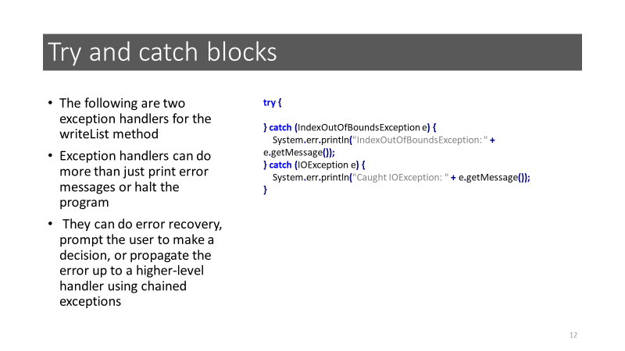
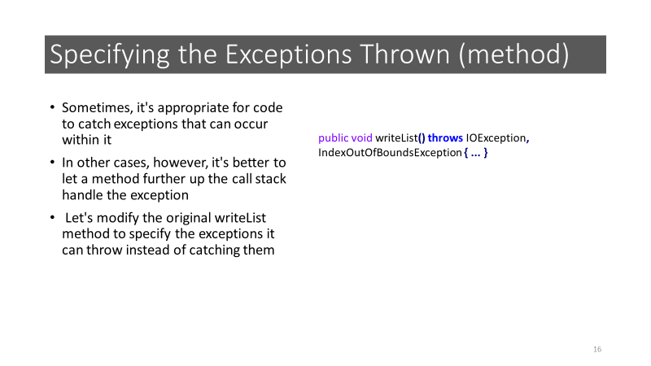
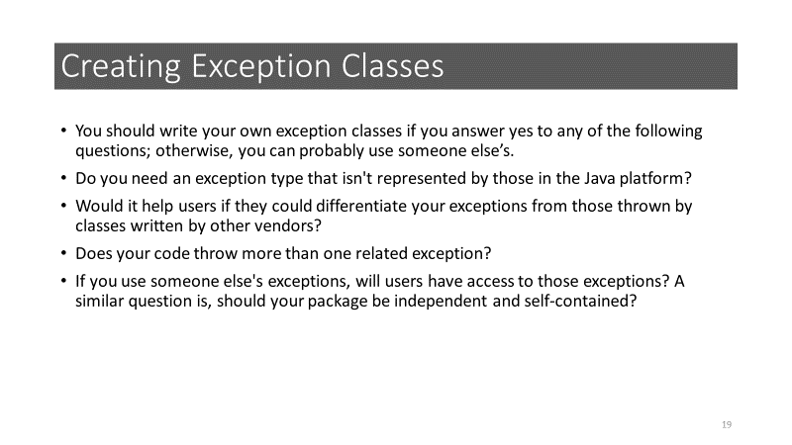
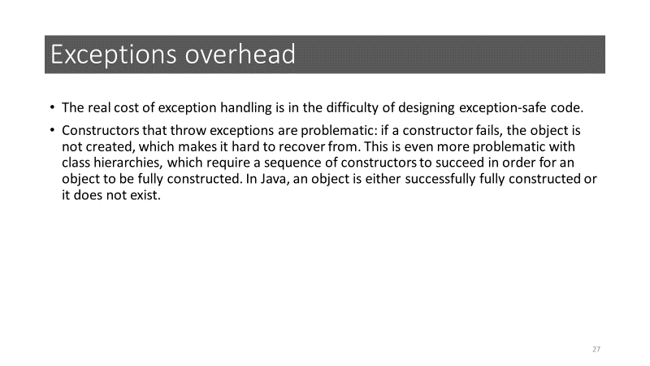

Slide 34
References
Oracle Corporation. The Java Tutorials: Exceptions.
Oracle Corporation. The Java Tutorials: The try-with-resources Statement.
Oracle Corporation. The Java Tutorials: Advantages of Exceptions.
Code Java .Net. How to create custom exceptions

